Slide 1
Design Credit
Mechanical Behavior Study using first principle calculations

Slide 2
Introduction
The deliverable for this course was:
1. Getting familiar with the relevant literature.
2. Preparation of input files for the calculations.
In this course I have studied about the first principle calculations which serves as a tool for various study in which my topic was mechanical behavior study of materials.

Slide 3
First Principles calculations
"First principles calculation" is a method to calculate physical properties directly from basic physical quantities such as the mass and charge, Coulomb force of an electron, etc. based on the principle of quantum mechanics.
Mechanical behaviour study
Mechanical properties e.g. ideal strength and elastic constants are accessible directly by first-principles calculations, such methods may predict the complex mechanical properties by extracting appropriate calculable parameters (e.g., the ratio of bulk modulus to shear modulus, the formation energies of and interaction energies between lattice defects)

Slide 4
In previous semester the main work is performed on the second deliverable that is preparation of input files for calculations, for this we have installed software vesta in which we created unit cells of various compounds using the necessary data , that are lattice parameters ,crystal structure ,space group etc.

Slide 5
lattice planes and directions

Slide 6
(110) closed packed plane
MoTe2

Slide 7
charge density unit cell of NaCl
Here the green isosurface depicts the positive charge and red surface depicts the negative charge around atoms.

Slide 8
monolayer of the unit cell ( MoTe2)

Slide 9
Unit cell of heterolayer with layers of MoTe2 and MoS2

Slide 10
Placing a water molecule in the cavity of the monolayer of the molecule

Slide 11

In the current semester the main focus was on the literature part . Various key concept are studied which are as follows:
Stiffness Tensor
Stress and strain are related to each other by Hooke’s Law where the strain is assumed to be sufficient small that stress and strain depend linearly on each other. Such a medium is called linear elastic. In its general form Hooke’s law reads:
It is often useful to express the anisotropic form of Hooke's law in matrix notation

Slide 12
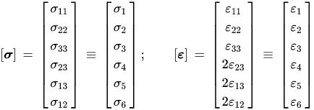
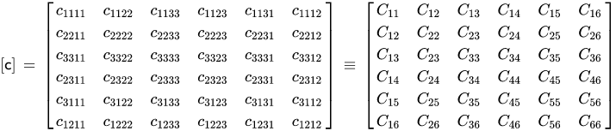
Then the stiffness tensor (c) can be expressed as

Slide 13
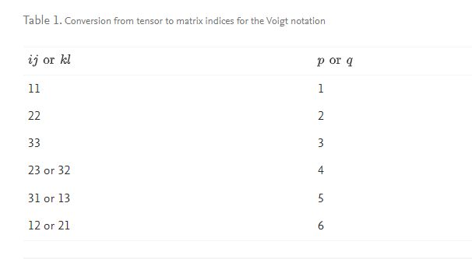
The stiffness tensor has four indices, i.e., it is a fourth order tensor and it cannot be represented in a plane array. To overcome this difficulty, Voigt matrix notation has been introduced to allow the stiffness tensor to be written as a matrix

Slide 14
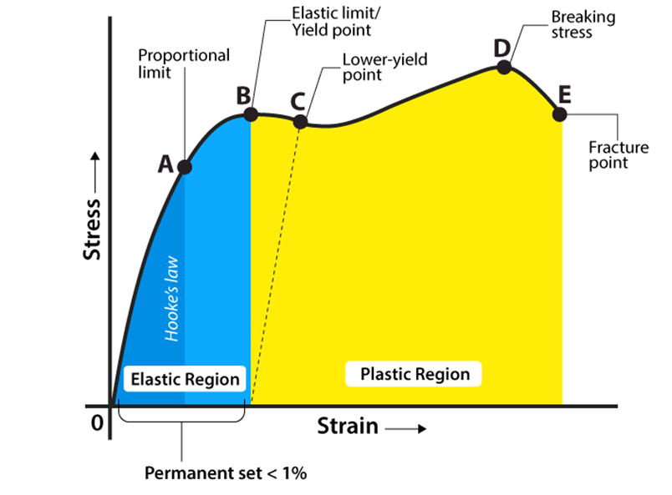
Stress-Strain Curve
When we study solids and their mechanical properties, information regarding their elastic properties is most important. We can learn about the elastic properties of materials by studying the stress-strain relationships, under different loads, in these materials.
The material’s stress-strain curve gives its stress-strain relationship. In a stress-strain curve, the stress and its corresponding strain values are plotted.

Slide 15
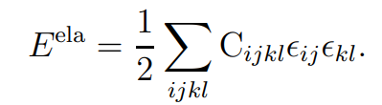

Elastic Energy
The elastic energy density is given by
For a cubic crystal structure
C11 = C22 = C33
C12 = C21 = C31 = C13 = C23 = C32
C44 = C55 = C66
Thus, in expanded form the total energy of a cubic crystal is given by:

Slide 16
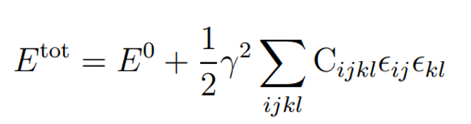
Homogenous Deformation Method (HDM)
This method is used to determine elastic constants of a crystal structure.
For a given strain tensor it is possible to write total energy in terms of elastic tensor elements and γ.
For calculating the complete elastic stiffness tensor of a crystal the same procedure is repeated using different homogeneous strain tensors
Here we write the number of independent equation equals to the number of unknown independent elastic constant , and then solve the linear equation using Linear Algebra.

Slide 17
e.g
Assuming n independent elastic constants
E_tot_1 = E_0 + ½ γ_1* ΣC*e_1*e_1’
E_tot_2 = E_0 + ½ γ_2* ΣC*e_2*e_2’
E_tot_3 = E_0 + ½ γ_3* ΣC*e_3*e_3’
……………………………………………….
……………………………………………….
E_tot_n = E_0 + ½ γ_n* ΣC*e_n*e_n’
Here only the elastic constant present in the summation are unknown which can be determined by solving the linear equations.

Slide 18
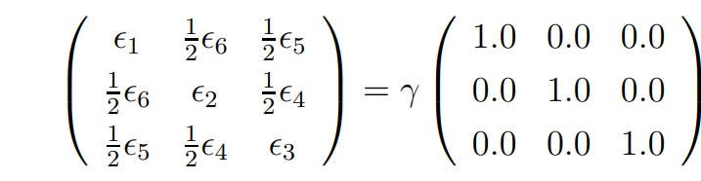
Bulk modulus calculation
Now we consider volume elasticity which involves changes in the volume of the body when it is subjected to compressional forces. If the compressional forces of equal magnitude are applied to all faces of a cube, its volume reduces. For uniform dilation (fractional change in volume), we must have:
ϵ1 = ϵ2 = ϵ3 = γ
ϵ4 = ϵ5 = ϵ6 = 0
The elastic energy is given by
3/2* γ^2 * (C11 + 2*C12)
In terms of Bulk modulus the elastic energy is given by
½ B * (3 γ)^2 = (9/2)*B* γ
, here (3γ) = δ = (V’-V)/V (Fractional change in the volume)

Slide 19
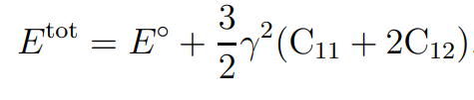
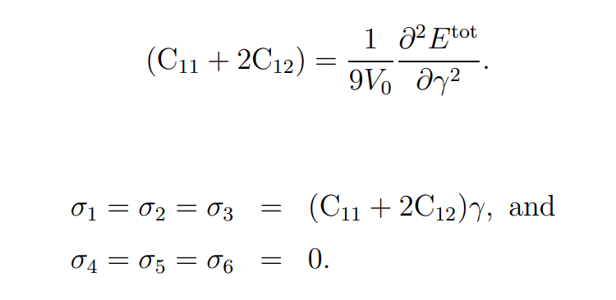
Equating both equations we get
B = (C11 + 2*C12)/3
The total energy is given by
Using this relation the bulk modulus values can be calculated from the curvature values:

Slide 20

Physical Work done on Linux
Learned basics of linux and how to use the terminal.

Slide 21
Calculating energy unit cell of Ni using quantum espresso
Install the quantum-espresso in your computer:The following command can be typed in terminal to install the "quantum-espresso“. sudo apt-get install quantum-espresso
Install optional visualisation software by typing the following command in the terminal: sudo apt-get install xcrysden
Edit the input file "ni.scf.in" as per the location of "pseudo_dir", "outdir“
Run the program with the given input file: <path to pw.x>/pw.x < ni.scf.in > ni.scf.out

Slide 22
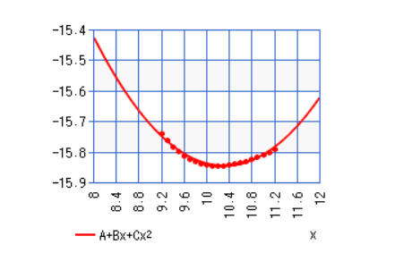
Calculating optimal lattice parameter of given unit cell in input file
Different energies are calculated at corresponding lattice parameter and a graph is plotted between lattice parameter and energies, here lattice constants are in the unit of Angstrom and energy in the unit of Ry (2.1798741E-18 J)

Slide 23
Energy is extrapolated as a second order polynomial of lattice parameter, from the graph the energy obtained is
E_a = -7.4979 + (-1.619)a + (0.078497)a^2
For minimum energy , dy/dx = 0
d(A+Bx+Cx^2)/dx = 0
2Cx+B = 0
x = -B/2C
The equilibrium lattice constant is ao = -(-1.619)/2*(0.078497)
= 10.313 A

Slide 24
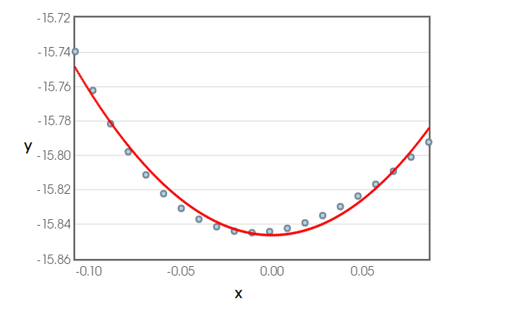

Calculating Bulk modulus from Energy vs Strain graph
The corresponding strains are obtained for all lattice parameter as (a-a0)/a0 , and a corresponding graph is obtained between Energy vs strain.

Slide 25
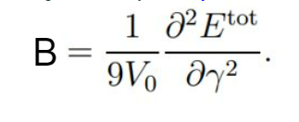
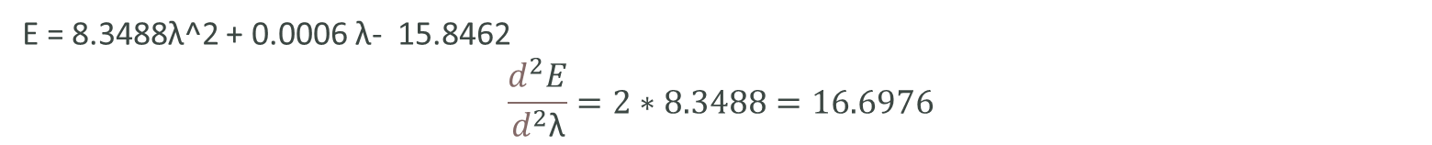
The Bulk modulus in terms of total energy and strain is given by
E = 8.3488λ^2 + 0.0006 λ- 15.8462
$$\frac{d^{2}E}{d^{2}\text{λ}}=2∗8.3488=16.6976$$
V0 = a0^3 = (10.313)^3 = 1096.87 A^3
B = (1/9*1096.87)*(16.6976) = 0.001691(Ry)^2/ A^5 = 0.001691 * (3.422402336 10 ^(-19) J)^2 * 10^50
= 0.0057885 * 10 ^12
= 5.7885 * 10^9 Pa
= 5.7885 Gpa

Slide 26
THANK YOU

